Slide 1
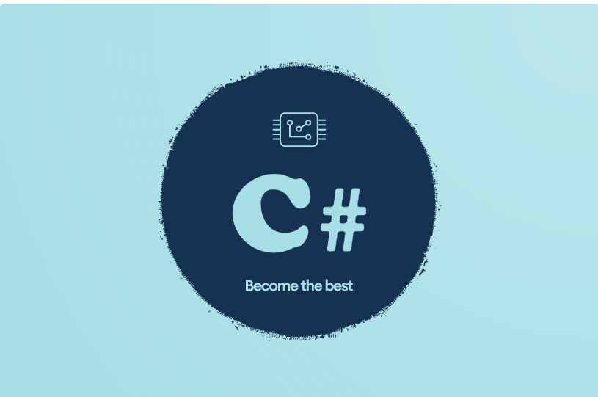
STRINGS

Slide 2
What is as string
The string class defined in the .NET base class library represents text as a series of Unicode characters. The string class provides methods and properties to work with strings
As string is a sequence of characters

Slide 3

Empty String
An empty string is a valid instance of a System.String object that contains zero characters. There are two ways to create an empty string. We can either use the string.Empty property or we can simply assign a text value with no text in it. The following code snippet creates two empty strings.
The following code snippet creates two empty strings.

Slide 4
How to define strings
Quoted string Literal
Verbatim string literal
Raw string literal
String interpolation
Verbatim string interpolation
Raw string interpolation
Raw string interpolation -JSON

Slide 5

Quoted string Literal
This is the first way of displaying strings . Here we use double quotes and escape characters to escape any special character.
Best for lines with no escape characters

Slide 6
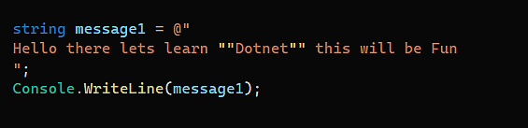
Verbatim string literal
Verbatim means as it is , it’s a way of displaying strings as they are.
It’s a works well for multi-line strings.
For quotation marks you need to use double quotation marks instead of escape characters.
For JSON Data this will look messy
Indentation is also a Problem

Slide 7
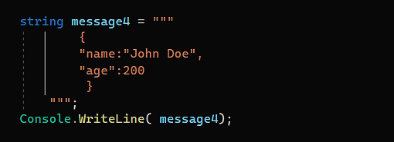

Raw string literal
These are available in C# 11
They start and end with at least three quotes
For single lines the opening and closing quotes should be on the same line
They allow whitespaces, special characters , new lines and embedded quotes.
Text must not outdent from the closing quotes.

Slide 8
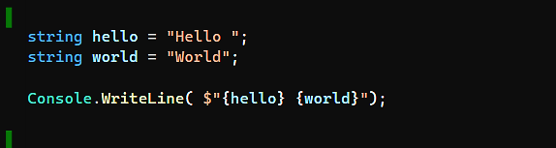
String interpolation
String interpolations allows embedding variables or any valid C# expression in a string literal.

Slide 9
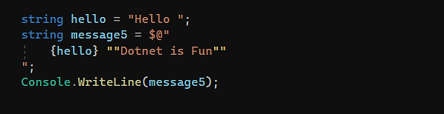
Verbatim string interpolation

Slide 10
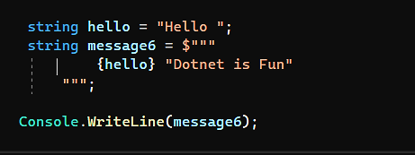
Raw string interpolation

Slide 11
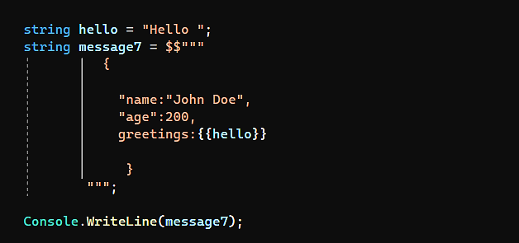
Raw string interpolation -JSON

Slide 12
String Data type
We have discussed the char datatype where we are storing a single character in it , char cannot store multiple characters so we need string if the number of characters exceed one.
In C# string is a reference data type if you go to the definition of a string you will see that it’s a class.
What Is the difference between String and string
The small string is an alias of the String , as per naming convention when creating a variable use the small string and whenever you want to invoke methods on the string use the capital string (i.e. String)

Slide 13

String are immutable
Immutable means that something can not be changed .
Whenever the first statement is executed a memory address is created in the memory and the memory address holds the value ‘JavaScript’, the variable language now holds the pointer to that object. Whenever the second statement executes another object is created that holds the value ‘C#’ and we store the pointer/reference to that object in the variable language .The first object is available for garbage collection

Slide 14
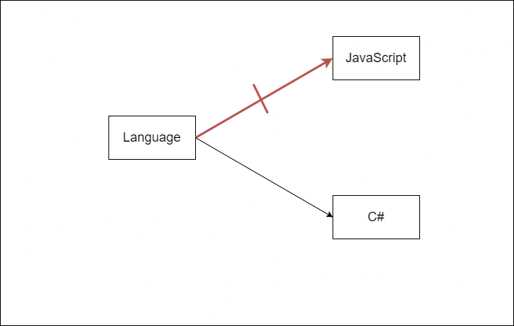
For value types it’s a bit different whenever I reassign a value to a value type no new memory location will be created rather it will override the value of the same location

Slide 15
String Intern in C#:
The String Intern in C# is a process that uses the same memory location if the value is the same. In our example, when the loop executes for the first time, it will create a fresh object and assign the value “DotNet Tutorials” to it. When the loop executes 2nd time, before creating a fresh object, it will check whether this “DotNet Tutorials” value is already there in the memory, if yes then it simply uses that memory location else it will create a new memory location. This is nothing but C# string interning.

Slide 16
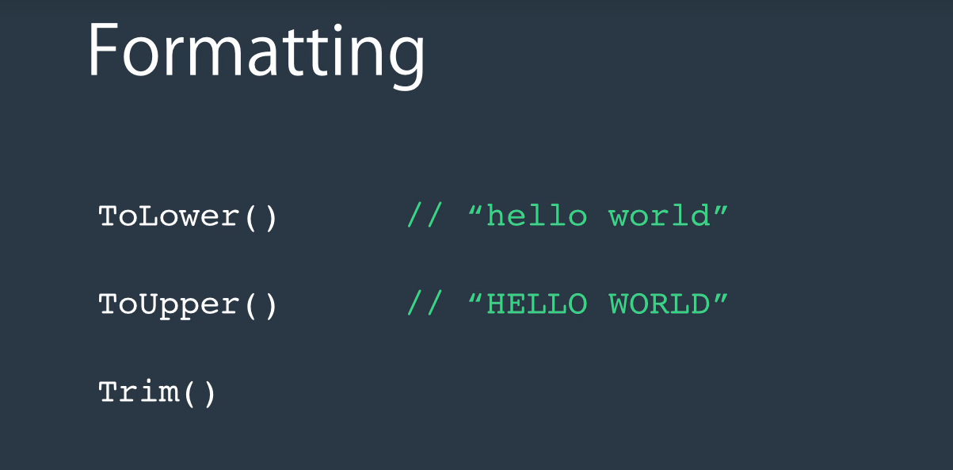
String Methods

Slide 17
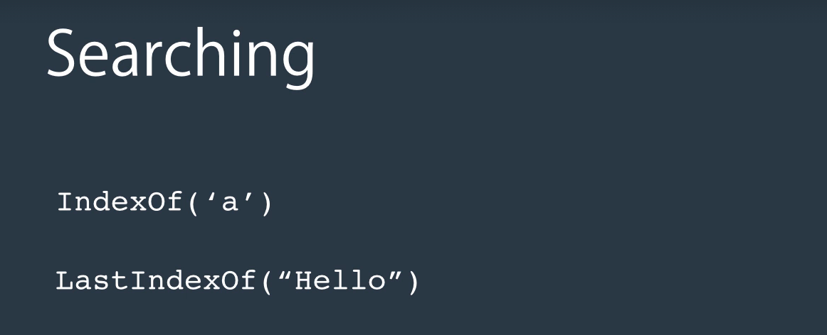

Slide 18
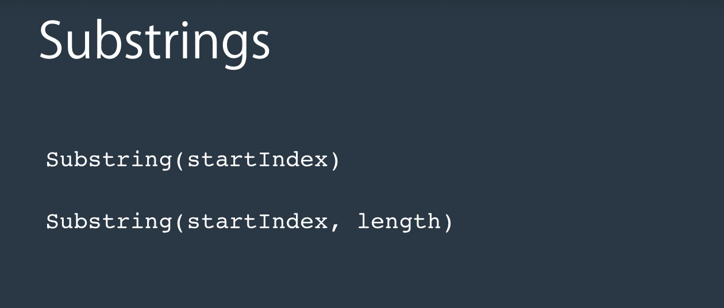

Slide 19
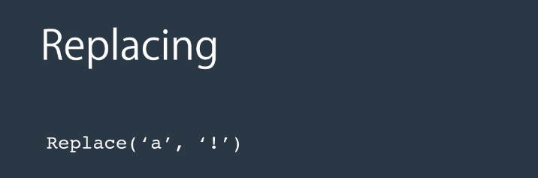

Slide 20
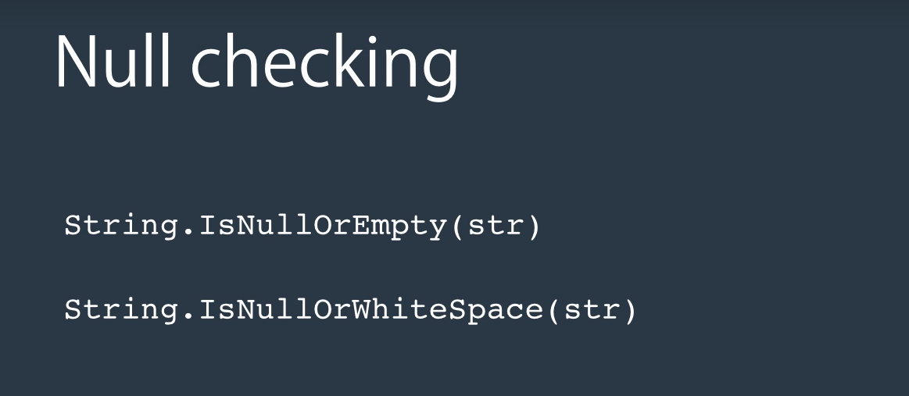

Slide 21
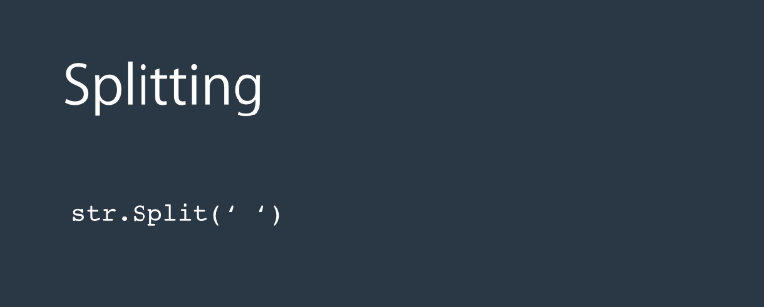

Slide 22
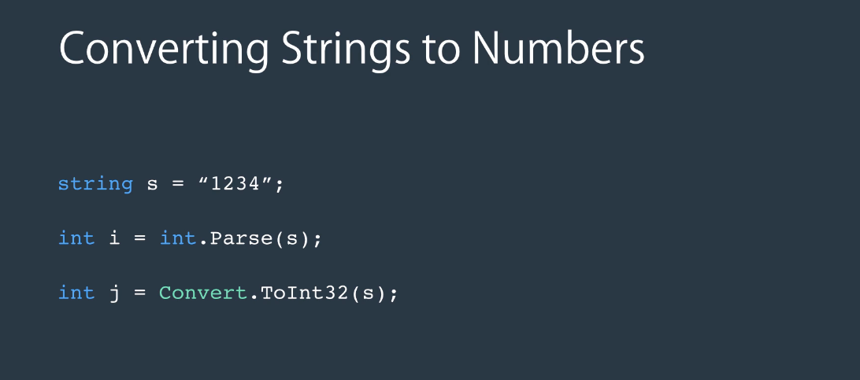

Slide 23
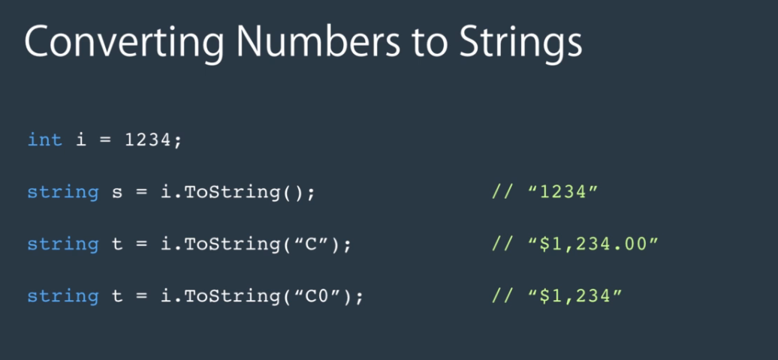
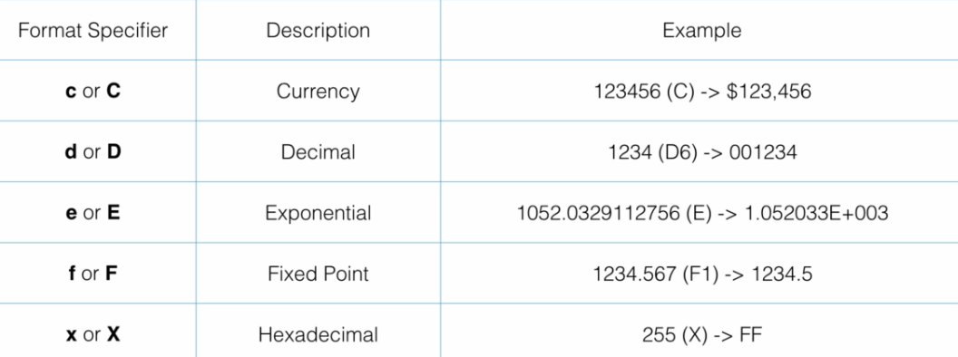

Slide 24
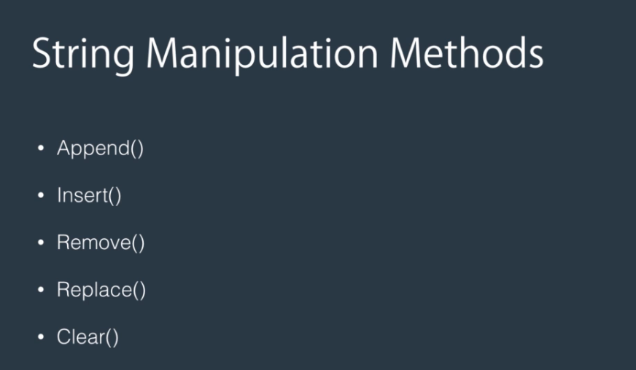
String Builder
Defined in System.Text
It’s a Mutable string
Easy and fast to create and manipulate strings
Not optimized for searching

